Slide 1


Wataru Danjo
2022.10.10

Slide 2

Outline
Executive Summary
Introduction
Methodology
Results
Conclusion
Appendix

Slide 3
Executive Summary
In this capstone project, we will predict if the Falcon 9 first stage will land successfully.
We investigate the actual landing data of SpaceX and find some relations.
From this project result, we can determine that the best prediction model are SVM, Logistic regression and KNN model.
This prediction model will help us make our strategy for future investment.

Slide 4
Introduction
SpaceX advertises Falcon 9 rocket launches on its website with a cost of 62 million dollars; other providers cost upward of 165 million dollars each, much of the savings is because SpaceX can reuse the first stage.
Therefore if we can determine if the first stage will land, we can determine the cost of a launch. This information can be used if an alternate company wants to bid against SpaceX for a rocket launch.
From this points, our question is “Will the first stage land successfully with given Falcon 9?”

Slide 5

Section 1

Slide 6
Methodology
Data is collected from the SpaceX API and web scraping from Wikipedia. Then we arrange our data with numerical number which can be used for predicting models.
Using this useful data, we visualize them with Seaborn and SQL. Also, we create map with Folium and Dashboard with Plotly Dash.
Finally, we test some prediction model and decide the best prediction model.

Slide 7
Data Collection – SpaceX API
Request and parse data using get request
Filter data, include Falcon 9 launches
Deal with missing values
Git hub URL: https://github.com/watanjo/CapstoneProject/blob/master/1.CollectingTheData.ipynb

Slide 8
Data Collection - Scraping
Request Falcon 9 launch wiki page from URL
Extract all data from HTML table
Create data table
Git hub URL: https://github.com/watanjo/CapstoneProject/blob/master/2.DataCollectionWithWebScraping.ipynb

Slide 9
Data Wrangling
Calculate the number of launches on each site
Calculate the number and occurrence of each orbit
Calculate the number and occurrence of mission outcome
Create a landing outcome from outcome column
Git hub URL: https://github.com/watanjo/CapstoneProject/blob/master/3.DataWrangling.ipynb

Slide 10
EDA with Data Visualization
Import some visualization packages
Visualize the relationship between flight number and site
Visualize the relationship between Payload and site
Visualize the relationship between success rate and orbit type
Visualize the relationship between flight number and orbit
Visualize the relationship between payload and orbit
Visualize yearly trend of success rate
Git hub URL: https://github.com/watanjo/CapstoneProject/blob/master/5.EDAwithVisualization.ipynb

Slide 11
EDA with SQL
Displaying the names of the unique launch sites in the space mission --- Displaying 5 records where launch sites begin with the string 'CCA' --- Displaying the total payload mass carried by boosters launched by NASA (CRS) --- Displaying average payload mass carried by booster version F9 v1.1,
Listing the date when the first successful landing outcome in ground pad was achieved --- Listing the names of the boosters which have success in drone ship and have payload mass greater than 4000 but less than 6000 --- Listing the total number of successful and failure mission outcomes --- Listing the names of the booster versions which have carried the maximum payload mass --- Listing the failed landing outcomes in drone ship, their booster versions, and launch site names for in year 2015 --- Ranking the count of landing outcomes between the date 2010-06-04 and 2017-03-20, in descending order.
Git hub URL: https://github.com/watanjo/CapstoneProject/blob/master/4.EDAwithSQL.ipynb

Slide 12
Build an Interactive Map with Folium
Using an interactive map with folium, we mark the success / failed launches for each site on the map.
And find these objects.
Are launch sites in close proximity to railways? : Yes
Are launch sites in close proximity to highways? : Yes
Are launch sites in close proximity to coastline? : Yes
Do launch sites keep certain distance away from cities? : Yes
Git hub URL: https://github.com/watanjo/CapstoneProject/blob/master/5.EDAwithVisualization.ipynb

Slide 13
Build a Dashboard with Plotly Dash
We create two charts in application
Pie chart : Success rate by each site
Scatter plot : Relationship between landing outcome and payload mass
From this result, our findings are below
Which site has the largest successful launches?
Which site has the highest launch success rate?
Which payload range(s) has the highest launch success rate?
Which payload range(s) has the lowest launch success rate?
Which F9 Booster version (v1.0, v1.1, FT, B4, B5, etc.) has the highest
Git hub URL:https://github.com/watanjo/CapstoneProject/blob/master/spacex_dash_app.py

Slide 14
Predictive Analysis (Classification)
Create column 'Class'
Standardizing data
Creating training and test set
Find best prediction model
Git hub URL: https://github.com/watanjo/CapstoneProject/blob/master/7.MachineLearningPrediction.ipynb

Slide 15
Results
The results of the exploratory data analysis revealed that the success rate of the Falcon 9 landings was 66.66%
The predictive analysis results showed that Logistic regression, SVM and KNN model are the best classification method with an accuracy of 83%

Slide 16

Section 2

Slide 17
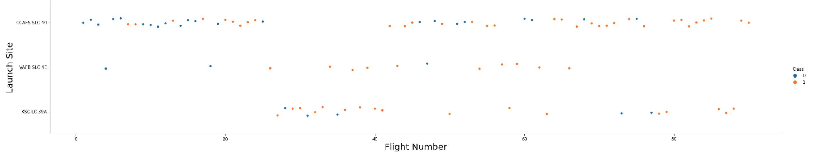
Flight Number vs. Launch Site
This figure shows that the success rate increased as the number of flights increased.
The blue dots represent the successful launches while the orange dot represent unsuccessful luanches.
There seems to be an increase in successful flights after the 40th launch.

Slide 18
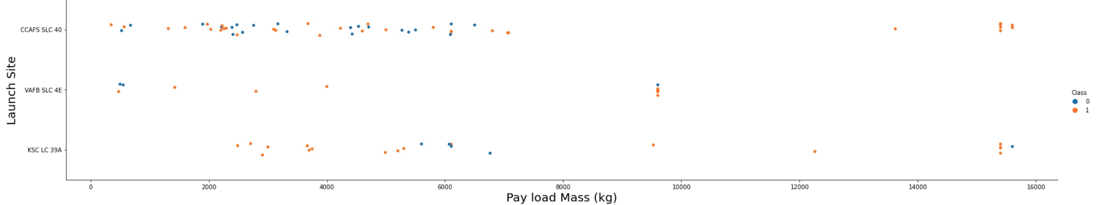
Payload vs. Launch Site
The blue dots represent the successful launches while the red dots represent unsuccessful launches.
For the VAFB-SLC launchsite there are no rockets launched for heavy payload mass
There seems to be a weak correlation between Payload and Launch Site and therefore decisions cannot be made using this metric.
The blue dots represent the successful launches while the orange dots represent unsuccessful launches.
For the VAFB-SLC launchsite there are no rockets launched for heavy payload mass
There seems to be a weak correlation between Payload and Launch Site and therefore decisions cannot be made using this metric.

Slide 19
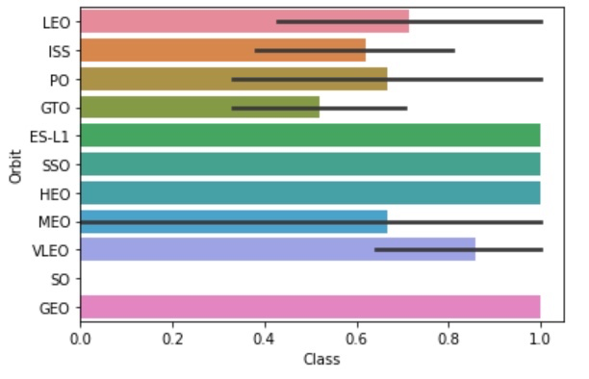
Success Rate vs. Orbit Type
Orbits SSO, HEO, GEO, and ES-L1 have 100% success rates.

Slide 20
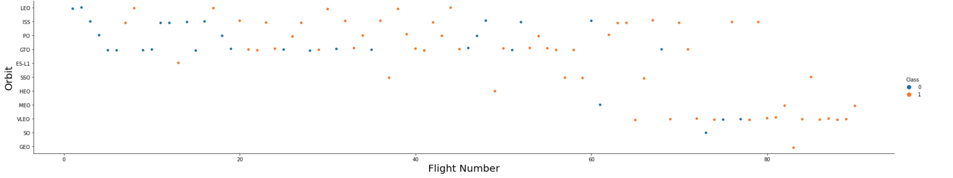
Flight Number vs. Orbit Type
The blue dots represent the successful launches while the orange dots represent unsuccessful launches.
In the LEO orbit, the success is positively correlated to the the number of flights.
There seems to be no relationship between flight number in the GTO orbit.
The SSO orbit has a 100% success rate however with fewer flights than the other orbits
FLights numbers greater than 40 have a higher success rate than flight numbers between 0-40.

Slide 21
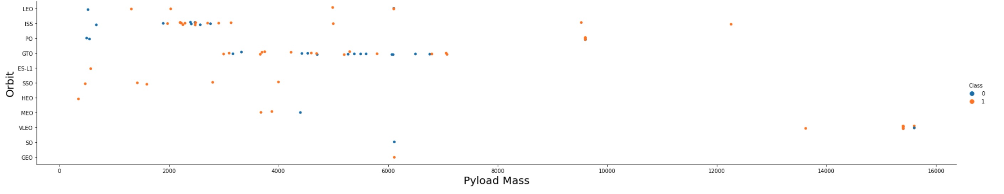
Payload vs. Orbit Type
As the payloads get heavier, the success rate increases in the PO, SSO, LEO and ISS orbits.
There seems to be no direct correlation between obrit type and payload mass for GTO orbit as both successful and failed launches are eually present

Slide 22
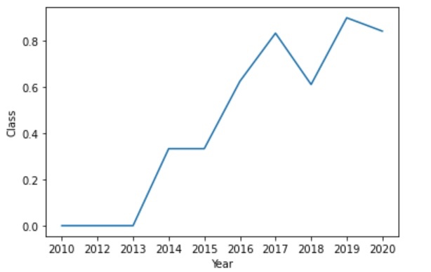
Launch Success Yearly Trend
The general trend of the chart shows an increase in landing success rate as the years pass. There is however a dip in 2018 as well as in 2020.

Slide 23
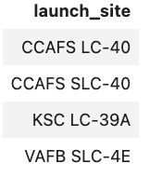
All Launch Site Names
Those are all launch site names

Slide 24
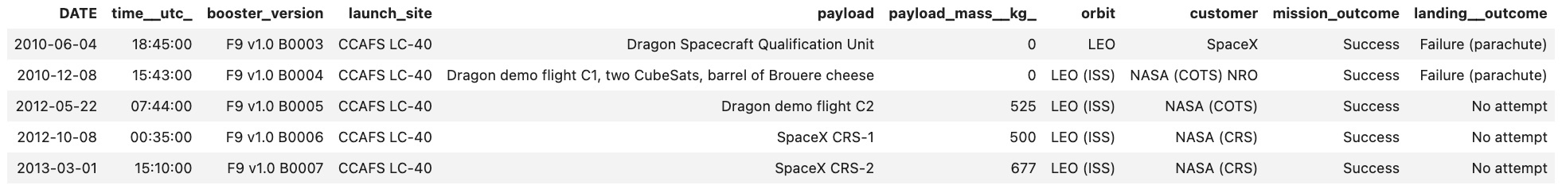
Launch Site Names Begin with 'CCA'
Launch sites begin with ‘CCA’

Slide 25
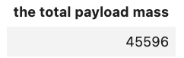
Total Payload Mass
The total payload mass carried byboosters launched by NASA(CRS)

Slide 26
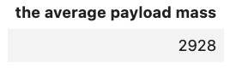
Average Payload Mass by F9 v1.1
The average payload mass carried by booster version F9 v1.1

Slide 27
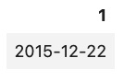
First Successful Ground Landing Date
The first successful landing outcome in ground pad was achieived

Slide 28
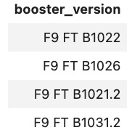
Successful Drone Ship Landing with Payload between 4000 and 6000
The names of the boosters which have success in drone ship and have payload mass greater than 4000 but less than 6000

Slide 29
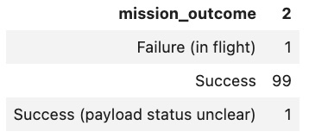
Total Number of Successful and Failure Mission Outcomes
The total number of successful and failure mission outcomes

Slide 30
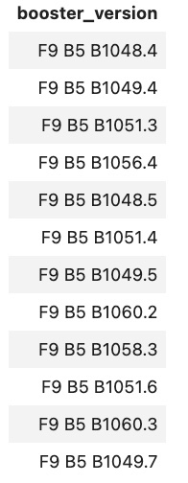
Boosters Carried Maximum Payload
The names of the booster_versions which have carried the maximum payload mass.

Slide 31
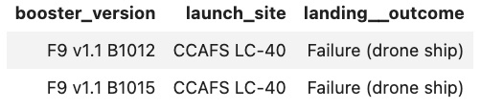
2015 Launch Records
The failed landing_outcomes in drone ship, their booster versions, and launch site names for in year 2015

Slide 32
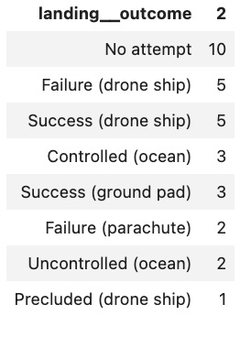
Rank Landing Outcomes Between 2010-06-04 and 2017-03-20
Rank the count of landing outcomes (such as Failure (drone ship) or Success (ground pad)) between the date 2010-06-04 and 2017-03-20, in descending order

Slide 33

Section 3

Slide 34
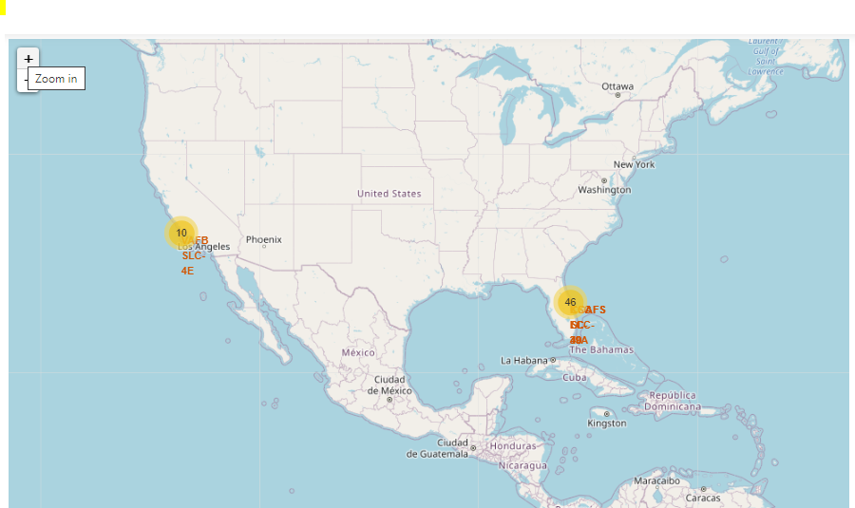
SpaceX Launch Sites Locations
The yellow markers are indicators of where the locations of all the SpaceX launch sites are situated in the US.
The launch sites have been strategically placed near the coast

Slide 35
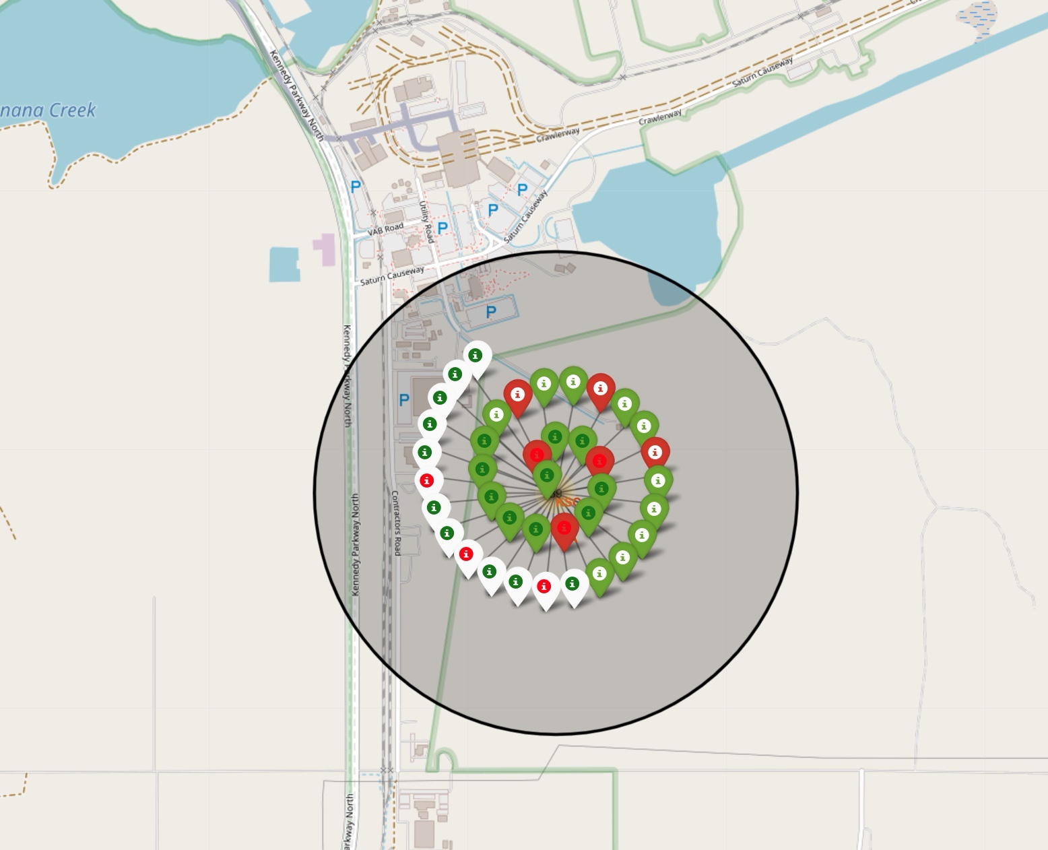
Success or failure point
When we zoom in on a launch site, we can click on the launch site which will display marker clusters of successful landings (green) or failed landing (red).

Slide 36
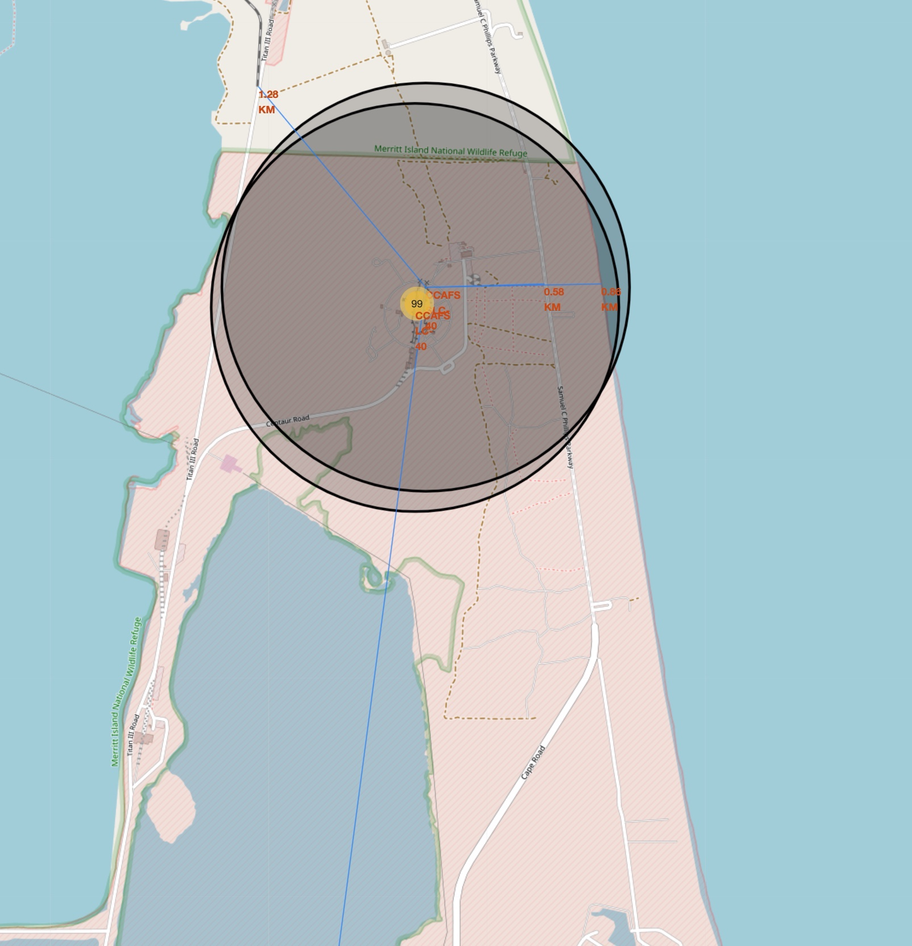
Location proximities
The generated map shows that the selected launch site is close to a highway for transportation of personnel and equipment. The launch site is also close to the coastlines for launch failure testing.
The launch sites also maintain a certain distance from the cities. (Can be viewed in notebook).

Slide 37

Section 4

Slide 38
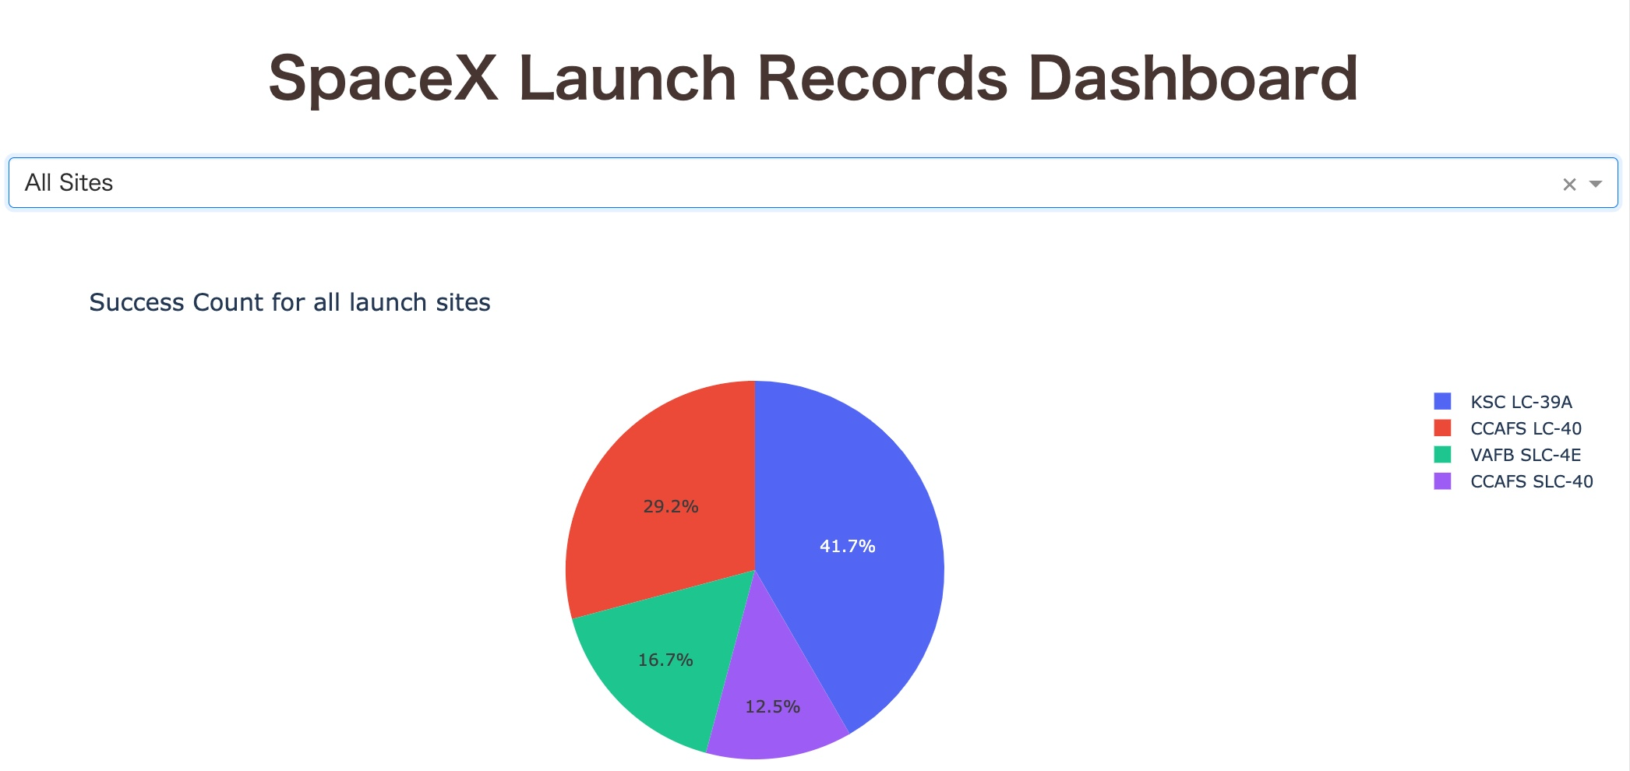
Total Success launches by site
KSC LC-39A is the best success site, compared to the other sites

Slide 39
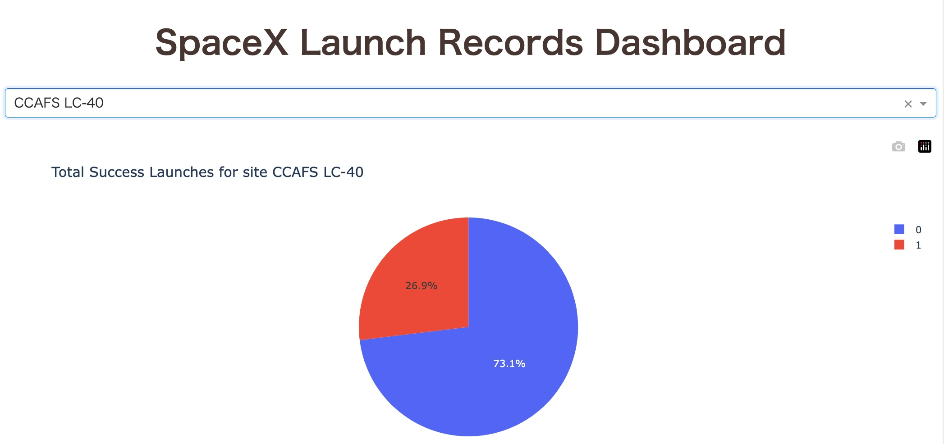
<Dashboard Screenshot 2>
CCAFS LC-40 success rate is 73.1%

Slide 40
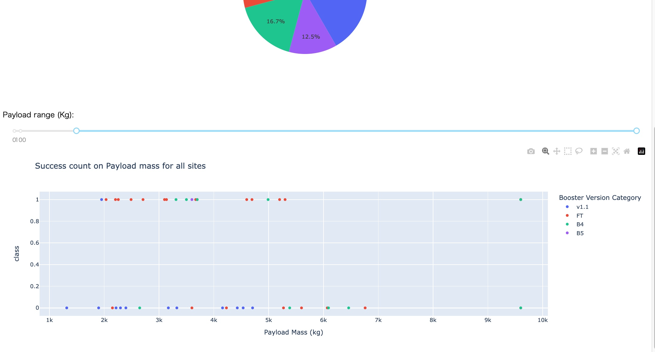
Success vs payload
The success rate (payload mass over 2,000) is slightly higher than lower mass load

Slide 41

Section 5

Slide 42
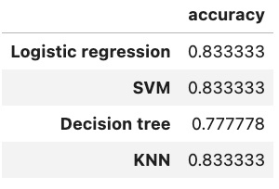
Classification Accuracy
The best prediction model are SVM, Logistic regression and KNN model.

Slide 43
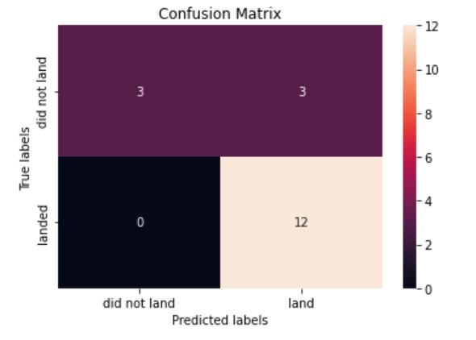
Confusion Matrix
Confusion Matrix of the best classification model is here

Slide 44
Conclusions
We can see that there is a positive correlation between number of flights and success rate. Also the success rate has improved over the years.
Orbits SSO, HEO, GEO, and ES-L1 have 100% success rates.
Success rate will be improved if the payload mass is higher.
The best prediction model are SVM, Logistic regression and KNN model.

Slide 45
Appendix
Github link(main): https://github.com/watanjo/CapstoneProject/tree/master
SpaceX wiki: https://en.wikipedia.org/wiki/List_of_Falcon_9_and_Falcon_Heavy_launches

Slide 46


